Slide 1
Scatter Plots, Correlation, and Causation

Slide 2
Scatter Plot
Scatter plot is a graph that is made up of points (x,y coordinates) that represent the relationship between two sets of data, also know as bivariate data, and are scattered around”.

Slide 3
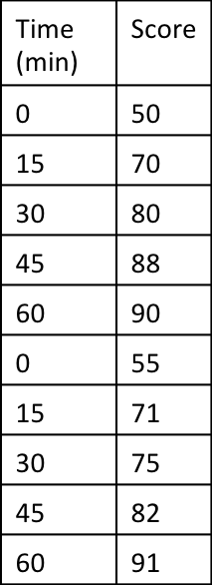
Scatter Plot Example
This scatterplot describes the relationship between minutes studying and score on a test. As the time spent studying increases, the test scores increase.
What would you predict is the test score for someone who spends 10 minutes studying?
59-63

Slide 4
How to describe using correlation coefficient, r?
Correlation tells us how two sets of data relate to one another. If there is correlation, then there is some sort of relationship.
Negative
Linear
Correlation
Positive
Linear
Correlation
No
Correlation
Non-Linear
Correlation

Slide 5
How do you describe Scatter plots using the correlation coefficient, r?
We can measure correlation coefficient, or the R-value. The correlation coefficient is always between -1 and 1, and tells us how close the scatter plot is forming a straight line.
r =-1 r = -0.8 r = -0.5 r = 0 r = .05 r = 0.8 r = 1
Strong Negative
Strong negative
Weak Negative
No correlation
Weak Positive
Strong Positive
Strong Positive

Slide 6
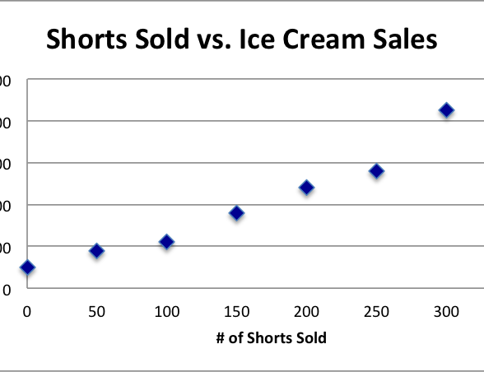
What is the difference between Correlation and Causation?
Is there Causation?
“Correlation does not imply causation”, is a common phrase in stats. It means correlation is not causation. Just because there is a relationship, it does not mean it is the cause.

Slide 7
Correlation or Causation
The age of a child and their shoe size.
The number of cars on the road and the number of accidents reported.
The number of sales made and the amount of commission earned.
A child’s weight and the size of her vocabulary.
The number of miles drive and the amount of gas used.
Correlation
Correlation
Causation
Correlation
Causation

