Slide 1
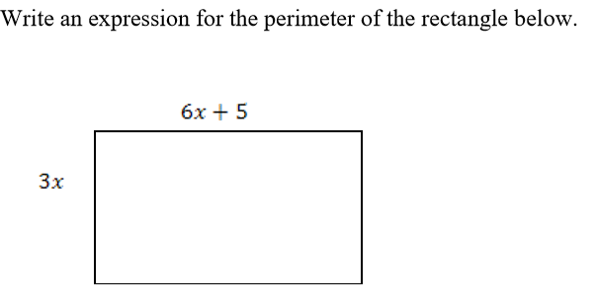
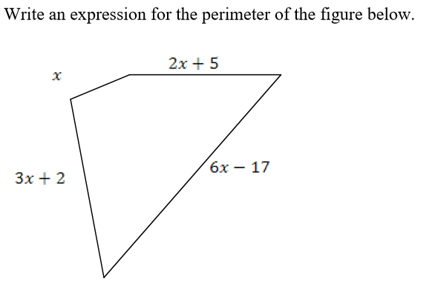
Happy Monday!
Pick up sheets from the table, put your stuff down at your assigned seat and then go straight to a whiteboard and complete the warmup.
Warmup—today you may chose any whiteboard to use.
On the boards, please solve the following problems:

Slide 2
Properties
Complete the Properties chart for notebook together (glue on right side of INB, this is page 5)
Define properties in words (put on the left side of INB, this is page 4)

Slide 3
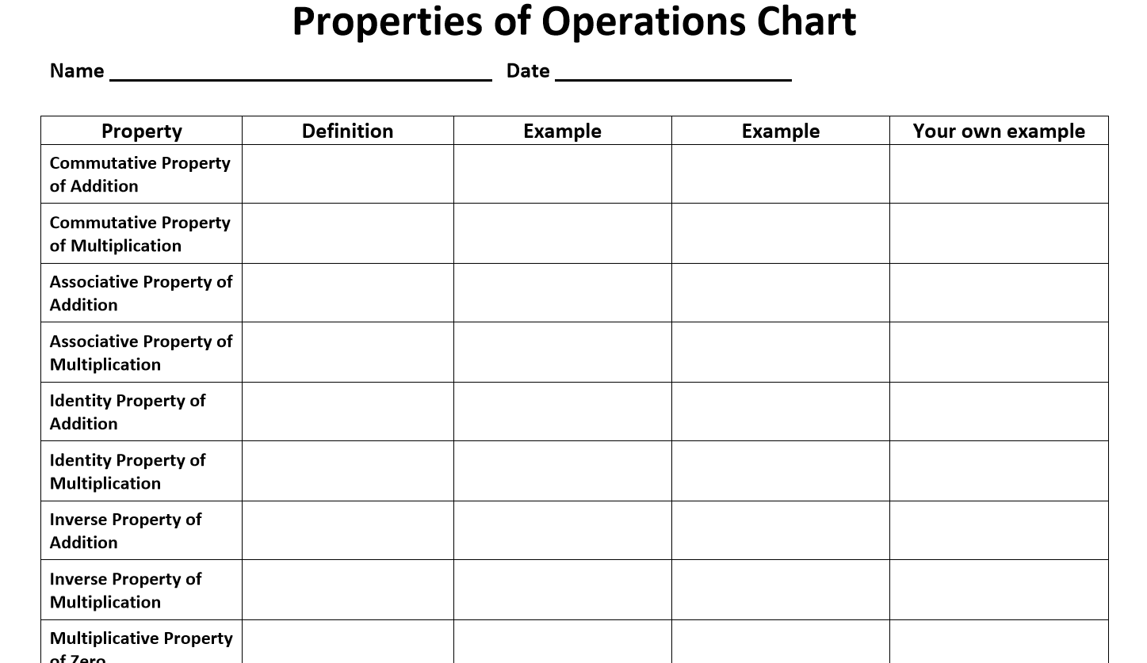
Properties Matching Activity
Each student needs a “Properties of Operations Chart”
I will place different examples on the screen and you will copy them down onto your chart where you think they should go
Make sure you pay attention to the operation being used!!

Slide 24
Answers
Let’s make sure that we all have the examples in the correct spots

Slide 25
Closer
Now you will create your own examples for each property in the last column of your chart
If you finish this early, then you may begin working on the homework worksheet for tonight

